Slide 1
STORAGE SOLUTION FOR THE LAB
Renato poli

Slide 2
Foreword
The lab is still in the 100 Mpbs era
Gigabit ethernet dates back to the late 1990s / early 2000s
This is terrible for cloud storage
The IT team is not being responsive.
I have 2 tickets open, but I have not received feedback
Format HD/install linux
Meeting on storage

Slide 3
UT solutions for storage
UT BOX
ONEDRIVE
Personal 2TB
Sharepoint 25TB
github
UT enterprise gitlab

Slide 4
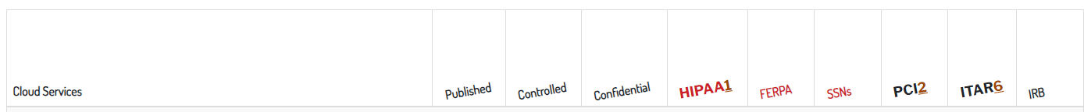
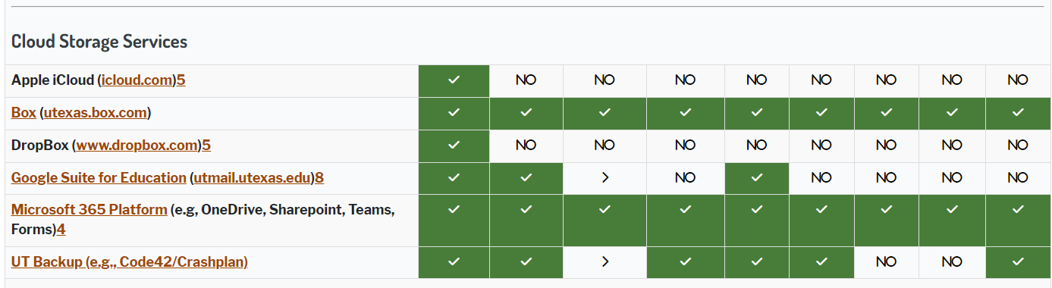
UT Cloud services
https://security.utexas.edu/iso-policies/cloud-services/decision-matrix
UT offers unlimited cloud storage for faculty at no cost.

Slide 5
UTBox
Download app for windows
https://www.box.com/box-for-devices/
Use it as a regular drive in windows explorer.

Slide 6
Onedrive
Industry standard
2TB quota for every student
Integrates well with MS Office 365

Slide 7
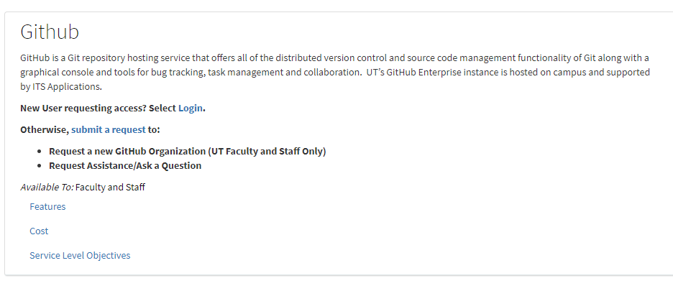
github / gitlab
Full support and control by UT
https://ut.service-now.com/sp?id=ut_bs_service_detail&sys_id=16d65c7c4ff9d200f6897bcd0210c786

Slide 8
github / gitlab

Slide 9
Recommendations
I don't see reasons for maintaining a local storage.
Hard disks die
only volatile daily data should be stored in single media.
Use Box or Onedrive for everyday documents
It looks like onedrive integrate better with MS Office
Box has intinite quota
Use Box for long-term backup
Data for finished papers, dissertation etc. must be sanitized, wrapped and stored in UTbox.
Use github for development and simulation decks
Use local working directory for volatile data.

Slide 10
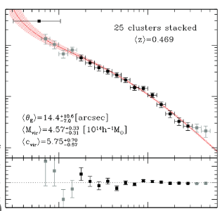
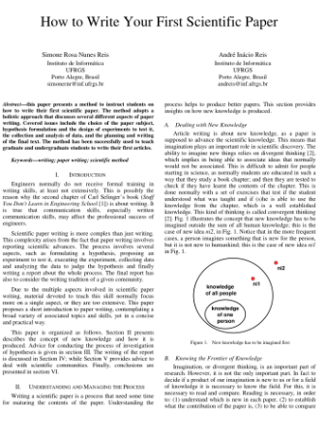
FAQ
What should be stored after a document is finished?
The document building blocks are part of the document inventory.
Database
Compilation
Files
Files
Files
Data
Database
Compilation
Files
Files
Files
Pictures, references,
...
Paper

Slide 11
FAQ
Does it make sense to ...
1 - use github?
It is an overall standard for any sort of source code development
Version control ensures redundancy, collaboration, reproducibility, history storage, traceability, recovery from crashes
2 - store large chunks of data in github?
Scientific data is problematic because it may be huge.
Few gigabites is ok for github (1Gb is download in 10sec).
Tens+ of gigabites starts demanding a little more thinking.
The best is probably to store the data in utbox with a clear identifier to be found when needed by pointers.

Slide 12
FAQ
What about maintanance?
Every database needs an active DBA. No DBA, no DB.
What about documentation?
Repository: github is use markups, which are very decent.
Python has its own standard documentation format. Easy and effective.
Doxygen is the best I used for Fortran and C++.

